Slide 1



HR Analytics in Power BI - Case Study
View in Power BI

Slide 2
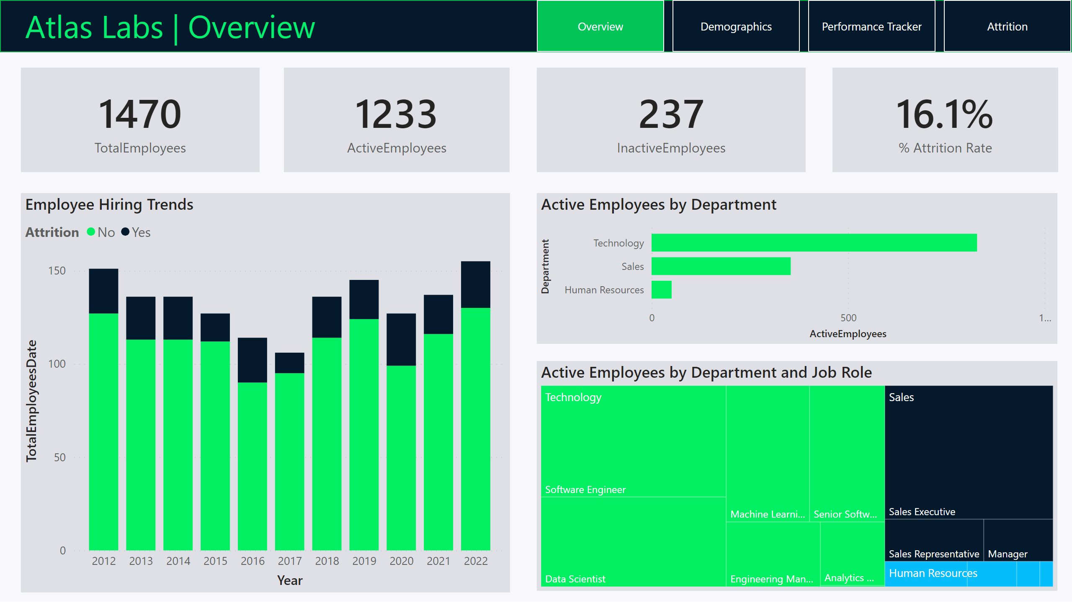
Overview
Notes:
card
No alt text provided
card
No alt text provided
card
No alt text provided
card
No alt text provided
Employee Hiring Trends
No alt text provided
Active Employees by Department
No alt text provided
Active Employees by Department and Job Role
No alt text provided
shape
No alt text provided
textbox
No alt text provided
pageNavigator
No alt text provided

Slide 3
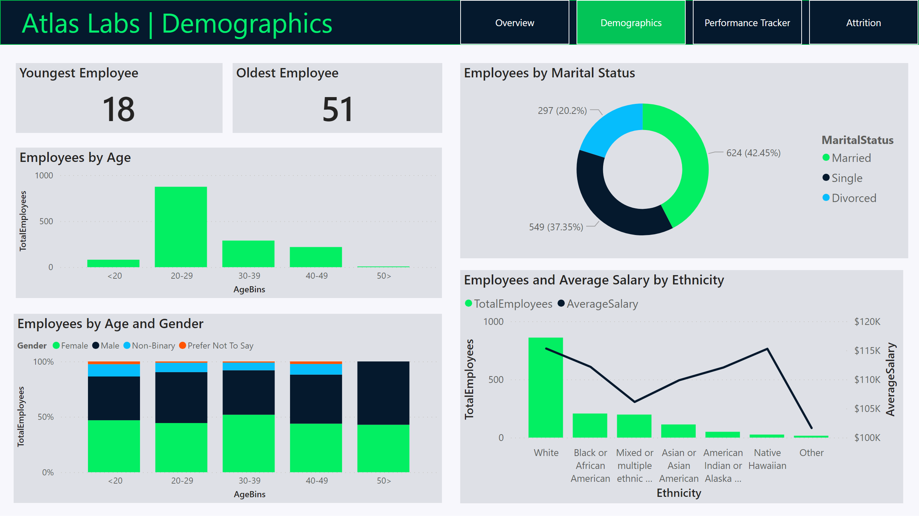
Demographics
Notes:
Youngest Employee
No alt text provided
Oldest Employee
No alt text provided
Employees by Age
No alt text provided
Employees by Age and Gender
No alt text provided
Employees by Marital Status
No alt text provided
Employees and Average Salary by Ethnicity
No alt text provided
textbox
No alt text provided
shape
No alt text provided
pageNavigator
No alt text provided

Slide 4
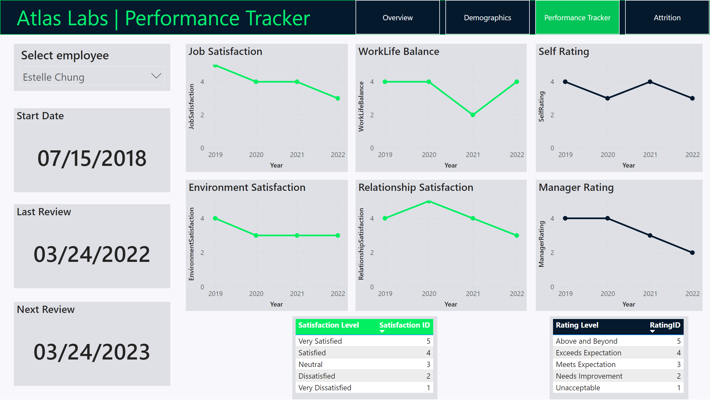
Performance Tracker
Notes:
slicer
No alt text provided
Start Date
No alt text provided
Next Review
No alt text provided
Last Review
No alt text provided
Job Satisfaction
No alt text provided
Environment Satisfaction
No alt text provided
WorkLife Balance
No alt text provided
Relationship Satisfaction
No alt text provided
Self Rating
No alt text provided
Manager Rating
No alt text provided
tableEx
No alt text provided
tableEx
No alt text provided
textbox
No alt text provided
shape
No alt text provided
pageNavigator
No alt text provided

Slide 5
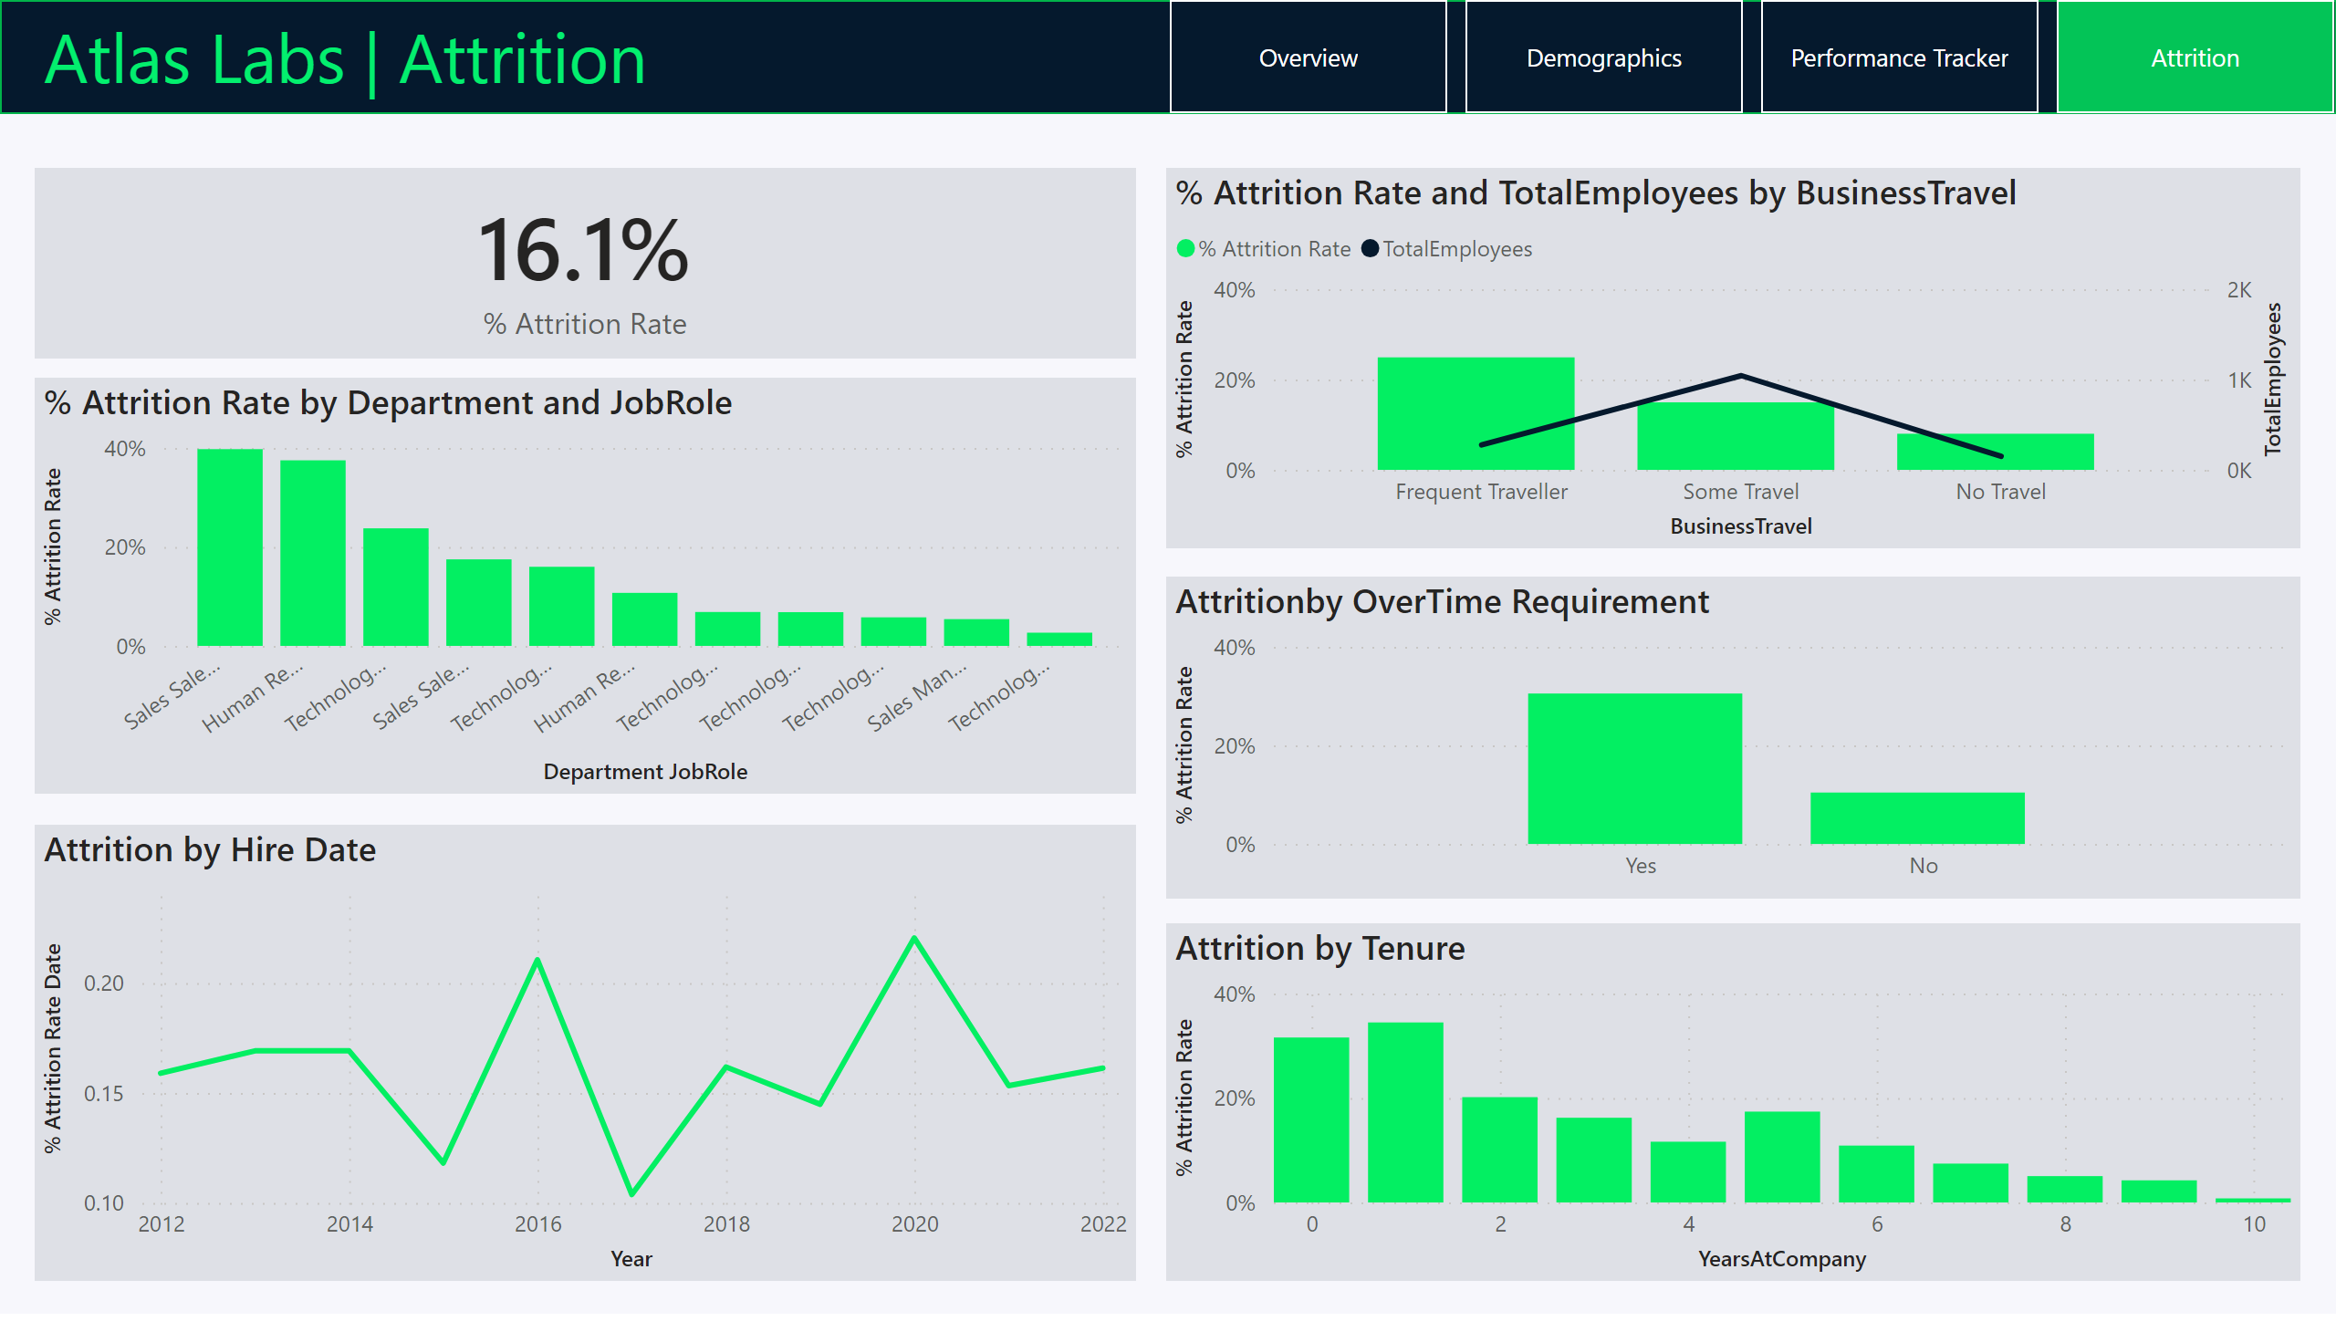
Attrition
Notes:
card
No alt text provided
columnChart
No alt text provided
Attrition by Hire Date
No alt text provided
lineStackedColumnComboChart
No alt text provided
Attritionby OverTime Requirement
No alt text provided
Attrition by Tenure
No alt text provided
textbox
No alt text provided
shape
No alt text provided
pageNavigator
No alt text provided

